Slide 1

Modeling Gene Regulatory Network
Mahroo Hajimehdi
Jan 2022

Slide 2

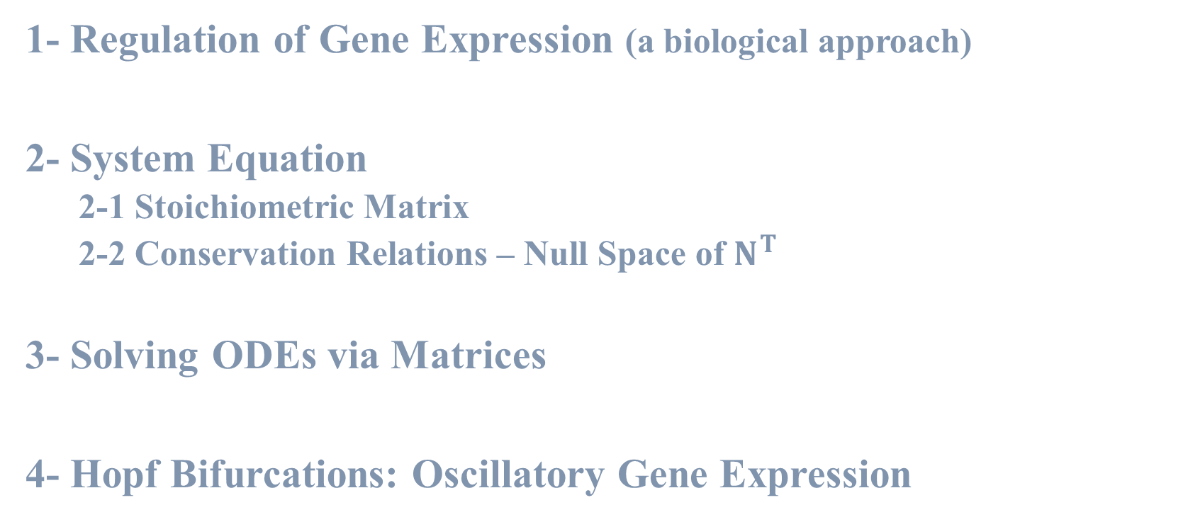
Overview of the main concepts
1- Regulation of Gene Expression (a biological approach)
2- System Equation
2-1 Stoichiometric Matrix
2-2 Conservation Relations – Null Space of $N^{T}$
3- Solving ODEs via Matrices
4- Hopf Bifurcations: Oscillatory Gene Expression

Slide 3

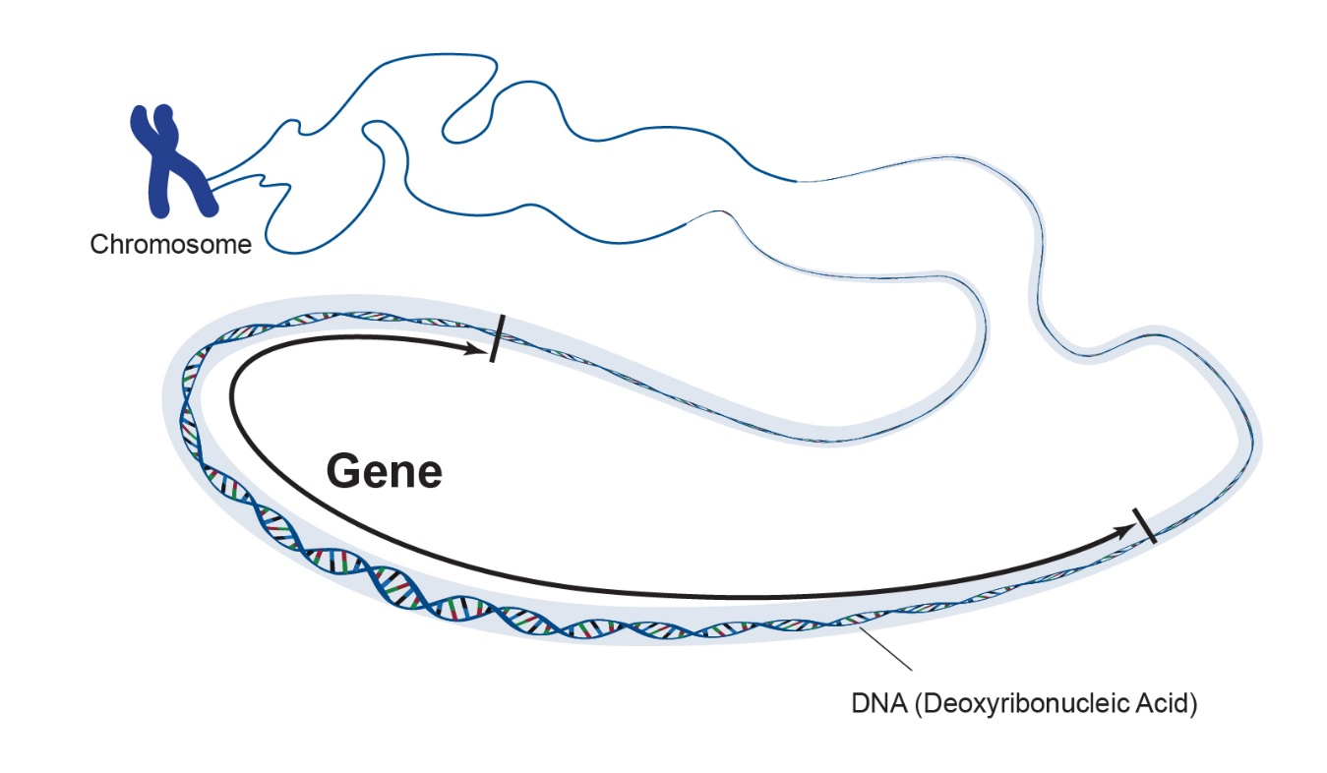
Regulation of Gene Expression (a biological approach)
Classically, a gene is defined as the information encoded by the sequence of a DNA region that is required for the construction of a protein.

Slide 4
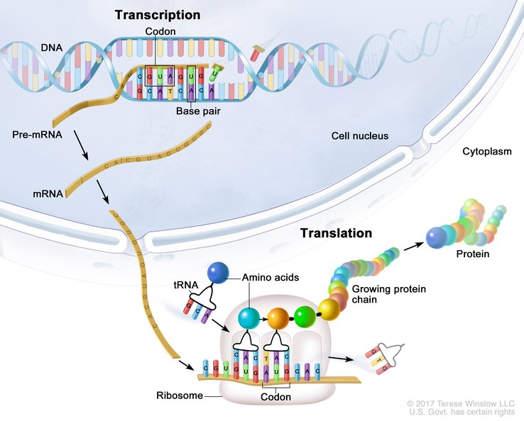
The term gene expression commonly refers to the whole process during which the information of a particular gene is translated into a particular protein. This process involves several steps:
1. Transcription
2. mRNA processing (in eukaryotic cells)
3. Translation

Slide 5
Gene expression in eukaryotes is controlled at six different steps:
Transcriptional control: when and how often is a gene transcribed.
RNA processing control: how is the RNA transcript spliced.
RNA transport and localization control: which mRNAs in the nucleus are exported to cytosol and where in the cytosol are they localized.
Translational control: which mRNAs in the cytosol are translated by ribosomes
mRNA degradation control: which mRNAs in the cytosol are destabilized.
Protein activity control: decide upon activation, inactivation, compartmentalization, and degradation of the translated protein.

Slide 6
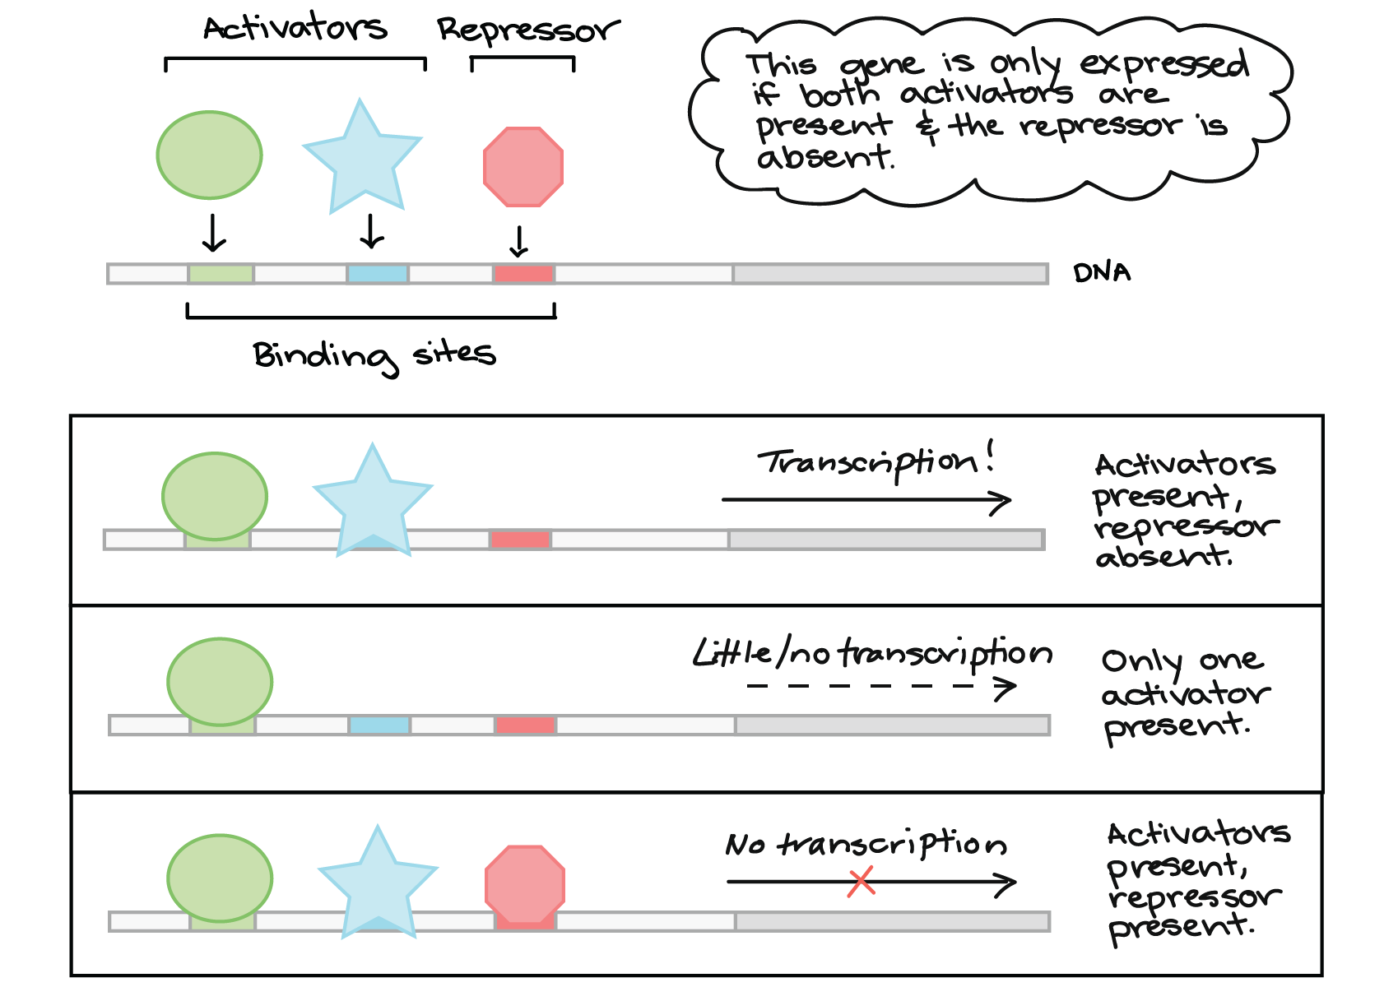
The expression level of the majority of genes is controlled by transcription factors. Transcription factors are proteins that bind to DNA regulatory sequences upstream of the site at which transcription is initiated.

Slide 7

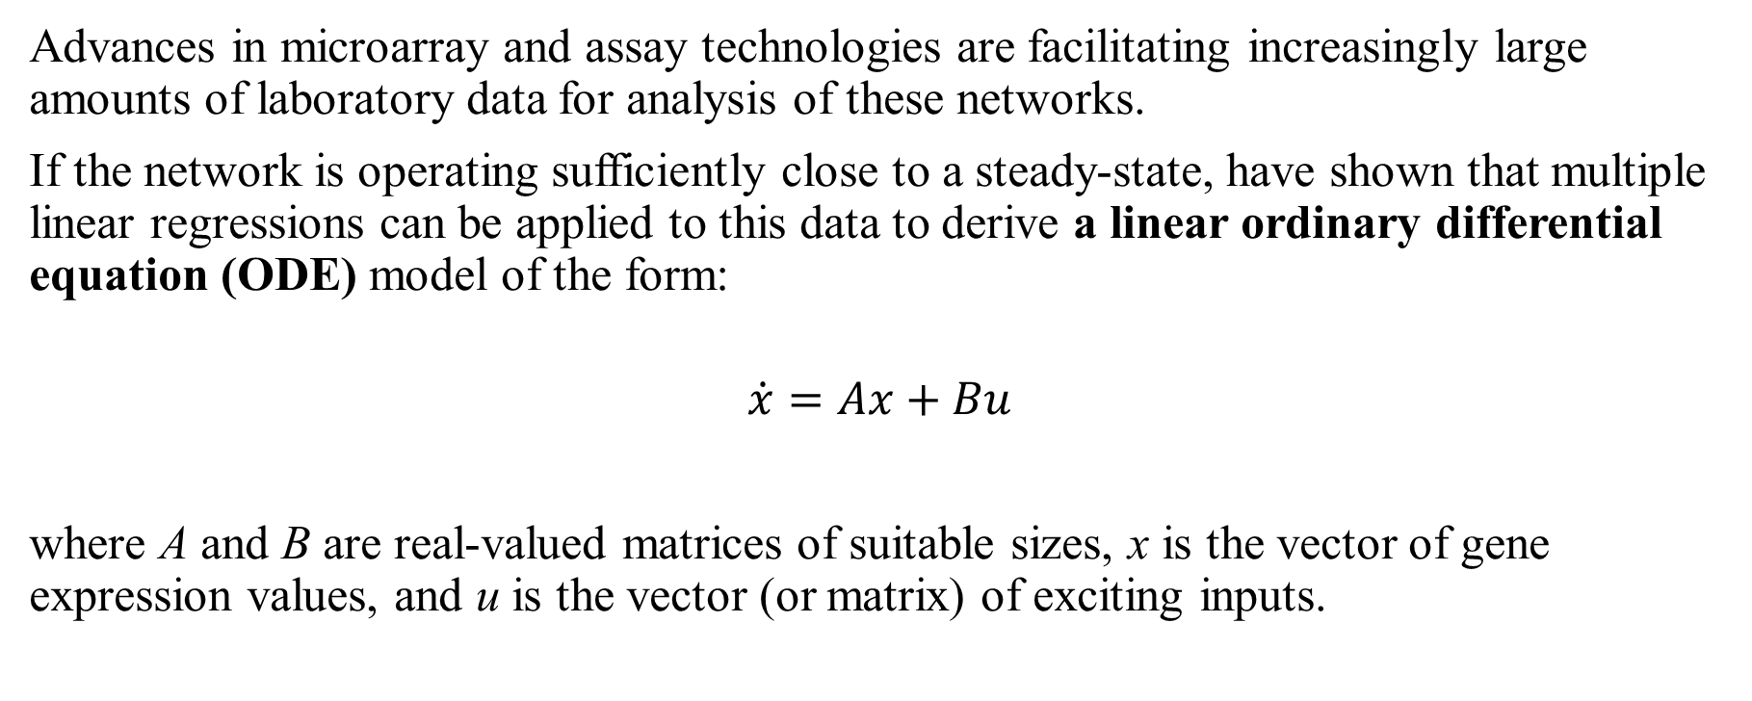
Advances in microarray and assay technologies are facilitating increasingly large amounts of laboratory data for analysis of these networks.
If the network is operating sufficiently close to a steady-state, have shown that multiple linear regressions can be applied to this data to derive a linear ordinary differential equation (ODE) model of the form:
$$\dot{x}=Ax+Bu$$
where A and B are real-valued matrices of suitable sizes, x is the vector of gene expression values, and u is the vector (or matrix) of exciting inputs.
Steady-state?
When a reaction involves one or more intermediates, if concentration of one of the intermediates remains constant at some stage of the reaction, the system has reached a steady-state

Slide 8

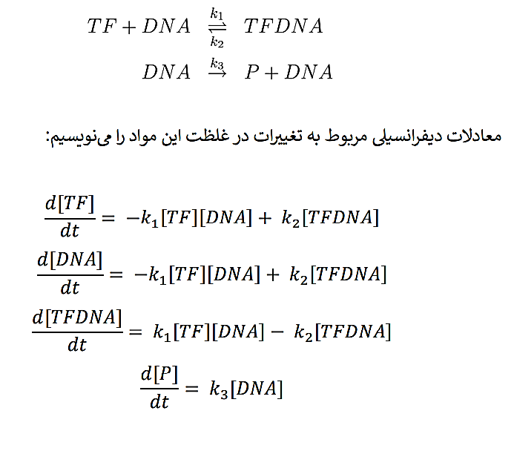
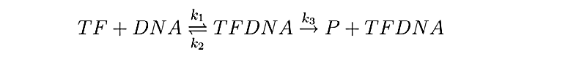
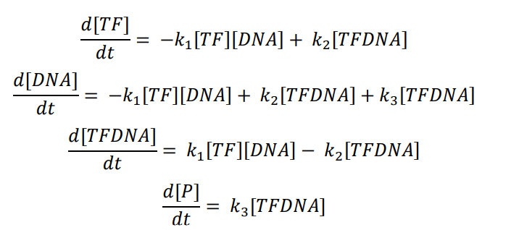
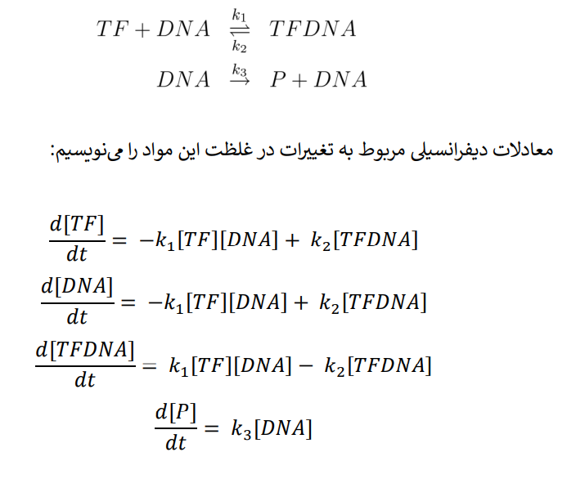
We can describe the dynamics of the TF binding network by a set of ordinary differential equations.
Activator TF Inhibitor TF
Back

Slide 9
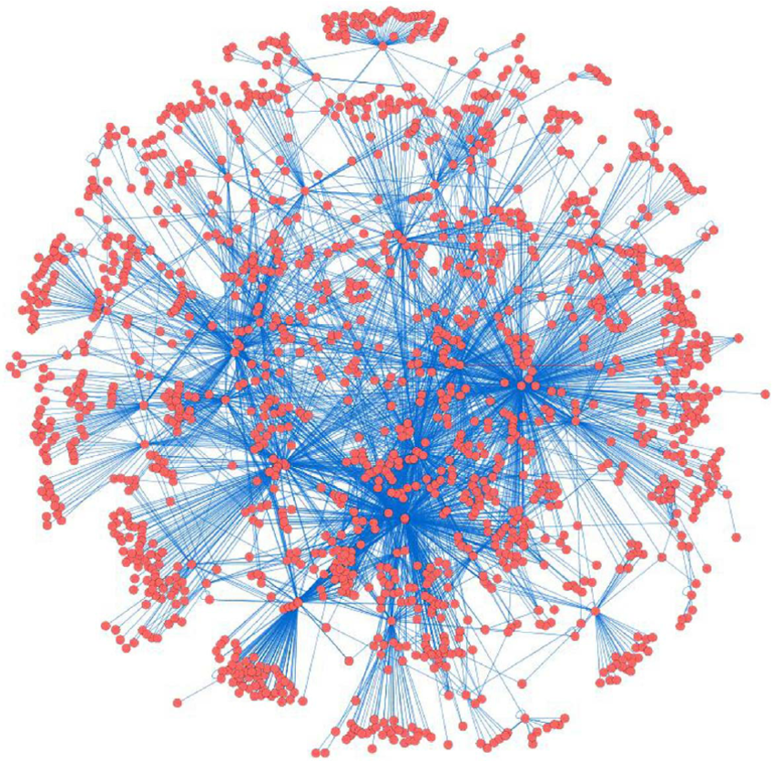

Slide 10
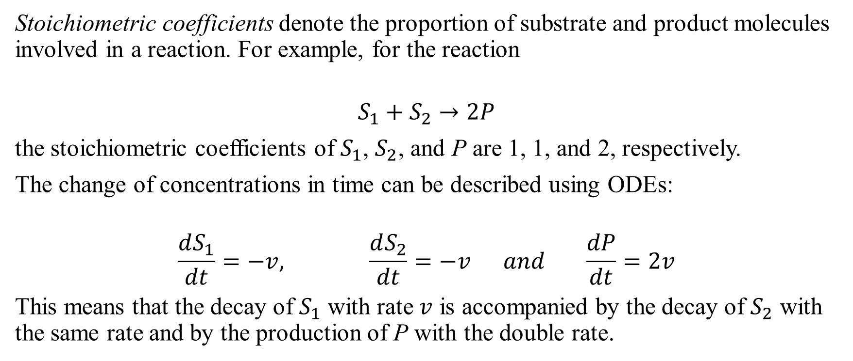
Stoichiometric Matrix
Stoichiometric coefficients denote the proportion of substrate and product molecules involved in a reaction. For example, for the reaction
$$S_{1}+S_{2}→2P$$
the stoichiometric coefficients of $S_{1}$, $S_{2}$, and P are 1, 1, and 2, respectively.
The change of concentrations in time can be described using ODEs:
$$\frac{dS_{1}}{dt}=−v, \frac{dS_{2}}{dt}=−v and \frac{dP}{dt}=2v$$
This means that the decay of $S_{1}$ with rate $v$ is accompanied by the decay of $S_{2}$ with the same rate and by the production of P with the double rate.

Slide 11
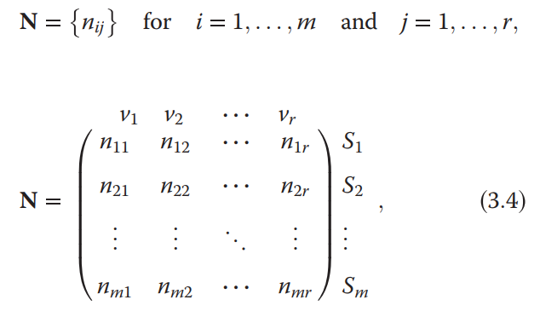
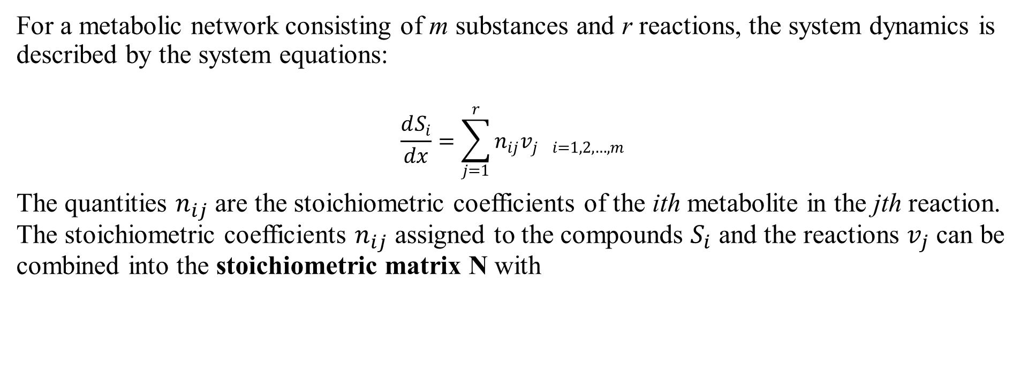
For a metabolic network consisting of m substances and r reactions, the system dynamics is described by the system equations:
$$\frac{dS_{i}}{dx}=\sum_{j=1}^{r}{n_{ij}v_{j i=1, 2,…,m}}$$
The quantities $n_{ij}$ are the stoichiometric coefficients of the ith metabolite in the jth reaction. The stoichiometric coefficients $n_{ij}$ assigned to the compounds $S_{i}$ and the reactions $v_{j}$ can be combined into the stoichiometric matrix N with
each column belongs to a reaction
each row to a compound.

Slide 12
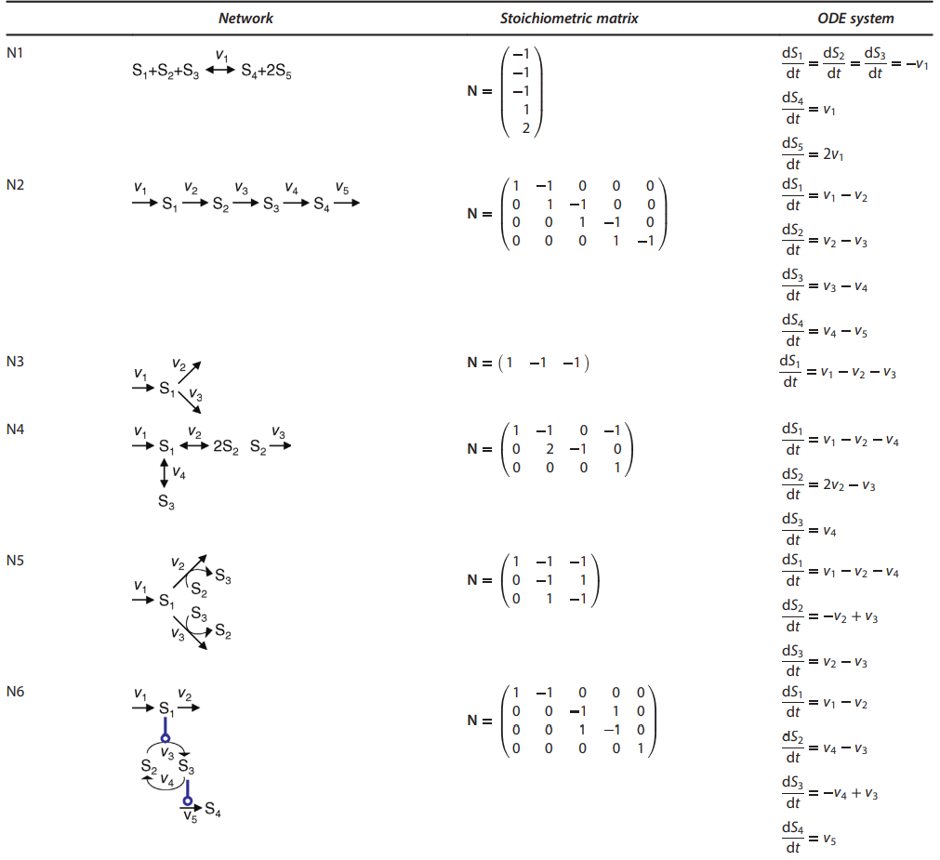

Slide 13
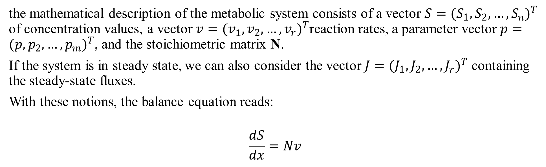
the mathematical description of the metabolic system consists of a vector $S={(S_{1}, S_{2},…, S_{n})}^{T}$ of concentration values, a vector $v={(v_{1}, v_{2},…, v_{r})}^{T}$reaction rates, a parameter vector$p={(p, p_{2},…, p_{m})}^{T}$, and the stoichiometric matrix N.
If the system is in steady state, we can also consider the vector $J={(J_{1}, J_{2},…, J_{r})}^{T}$ containing the steady-state fluxes.
With these notions, the balance equation reads:
$$\frac{dS}{dx}=Nv$$
Flux?
Flux or metabolic flux is the rate of turnover of molecules through a metabolic pathway.
Turnover rate?
The rate of substrate molecules transformed per minute by a single enzyme molecule.

Slide 14
2-1 Information Encoded in the Stoichiometric Matrix N
The stoichiometric matrix contains important information about the structure of the metabolic network;
- Calculate which combinations of individual fluxes are possible in steady state (i.e., calculate the admissible steady-state flux space)
- Find out dead ends and unbranched reaction pathways
- Discover the conservation relations for the included reactants.

Slide 15
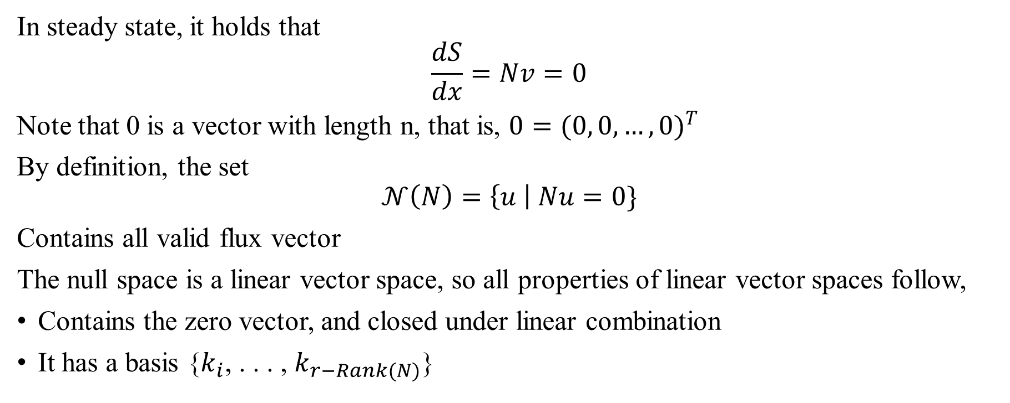
In steady state, it holds that
$$\frac{dS}{dx}=Nv=0$$
Note that 0 is a vector with length n, that is, $0={(0, 0,…, 0)}^{T}$
By definition, the set
$$𝒩\left(N\right)=\left\{u \right| Nu=0\}$$
Contains all valid flux vector
The null space is a linear vector space, so all properties of linear vector spaces follow,
Contains the zero vector, and closed under linear combination
It has a basis {$k_{i}$, . . . , $k_{r−Rank(N)}$}

Slide 16
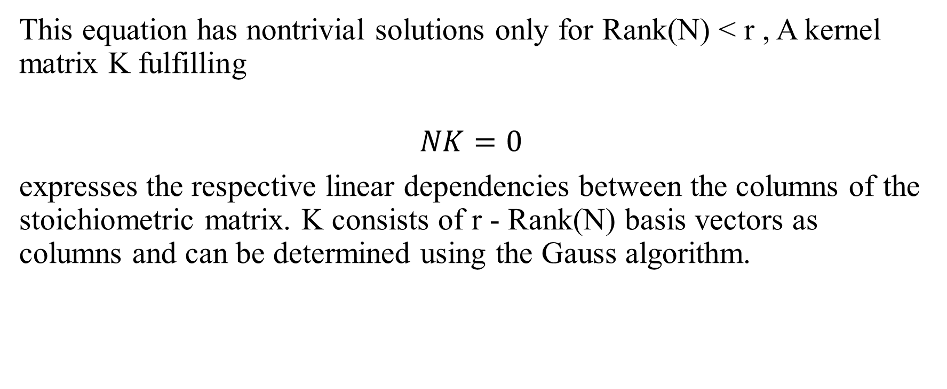
This equation has nontrivial solutions only for Rank(N) < r , A kernel matrix K fulfilling
$$NK=0$$
expresses the respective linear dependencies between the columns of the stoichiometric matrix. K consists of r - Rank(N) basis vectors as columns and can be determined using the Gauss algorithm.

Slide 17
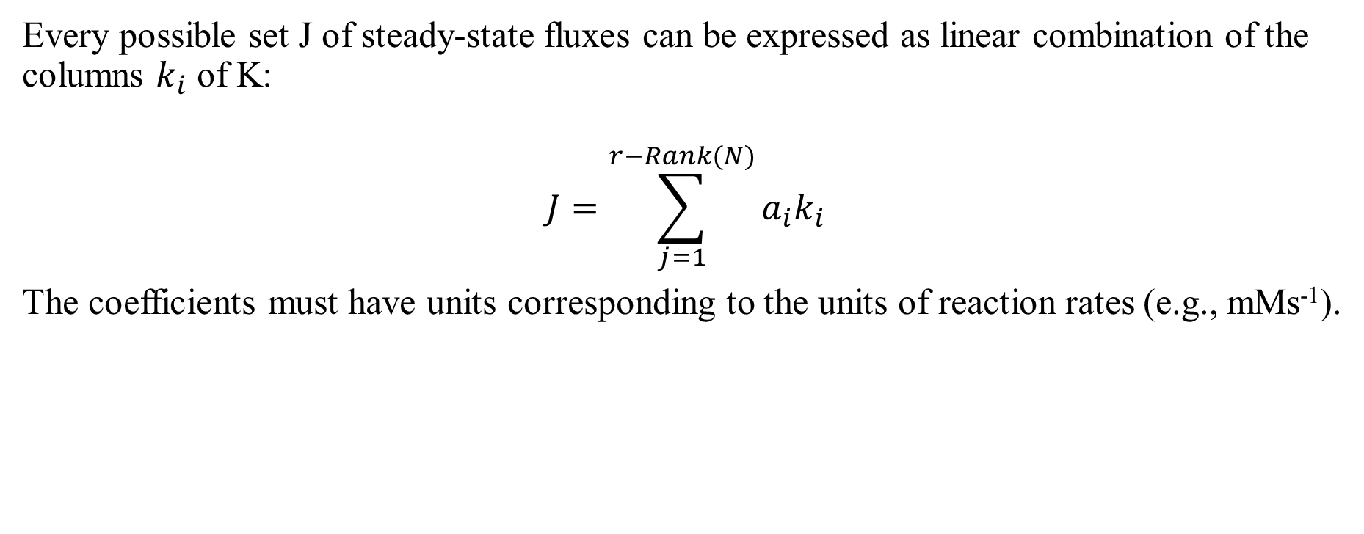
Every possible set J of steady-state fluxes can be expressed as linear combination of the columns $k_{i}$ of K:
$$J=\sum_{j=1}^{r−Rank(N)}{a_{i}k_{i}}$$
The coefficients must have units corresponding to the units of reaction rates (e.g., mMs⁻¹).

Slide 18
Three properties of the metabolic network can be found directly from the kernel matrix
Dead ends in metabolism (reactions that cannot carry a flux in any steady state): correspond to identically zero rows in the kernel
Enzyme subsets (reactions that are forced to operate in lock step in any steady state): correspond to kernel rows that are scalar multiples of each other
Independent components (groups of reactions that can carry flux independently from reactions outside the group): block-diagonal structure in the kernel
Dead end?
A dead-end metabolite (DEM) is defined as a metabolite that is produced by the known metabolic reactions of an organism and has no reactions consuming it.

Slide 19
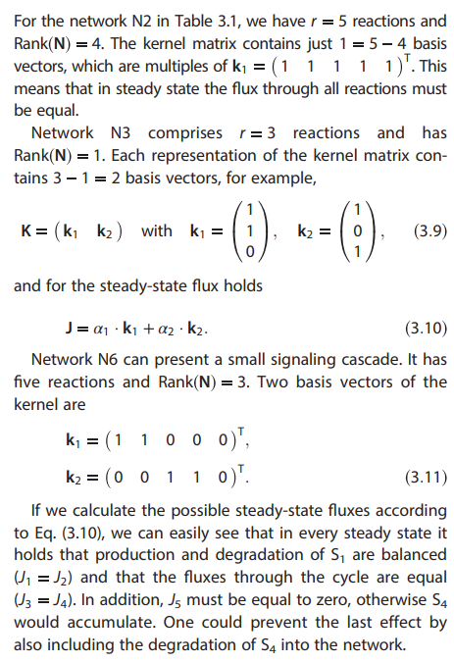

Slide 20
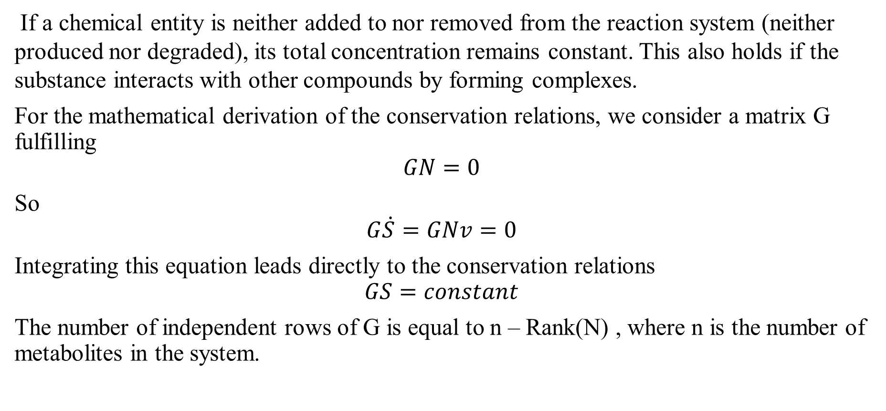

2-2 Conservation Relations – Null Space of $N^{T}$
If a chemical entity is neither added to nor removed from the reaction system (neither produced nor degraded), its total concentration remains constant. This also holds if the substance interacts with other compounds by forming complexes.
For the mathematical derivation of the conservation relations, we consider a matrix G fulfilling
$$GN=0$$
So
$$G\dot{S}=GNv=0$$
Integrating this equation leads directly to the conservation relations
$$GS=constant$$
The number of independent rows of G is equal to n – Rank(N) , where n is the number of metabolites in the system.

Slide 21
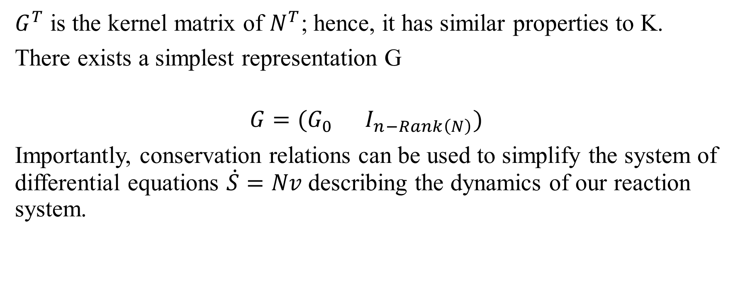
$G^{T}$ is the kernel matrix of $N^{T}$; hence, it has similar properties to K.
There exists a simplest representation G
$$G={(G}_{0 } I_{n−Rank\left(N\right)})$$
Importantly, conservation relations can be used to simplify the system of differential equations $\dot{S}=Nv$describing the dynamics of our reaction system.

Slide 22
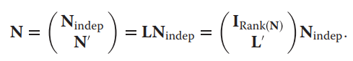
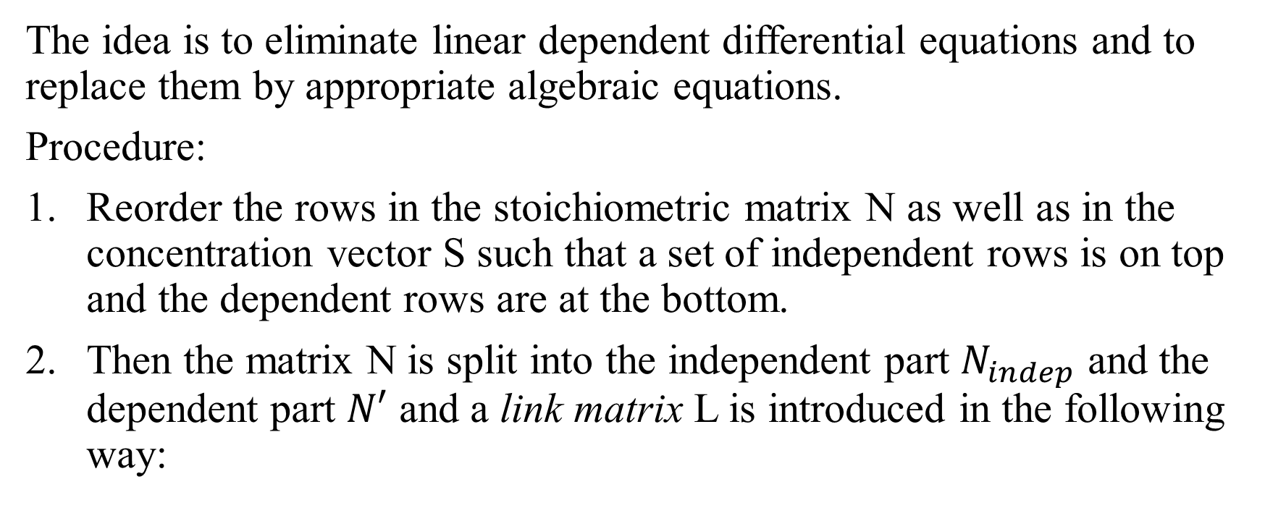
The idea is to eliminate linear dependent differential equations and to replace them by appropriate algebraic equations.
Procedure:
Reorder the rows in the stoichiometric matrix N as well as in the concentration vector S such that a set of independent rows is on top and the dependent rows are at the bottom.
Then the matrix N is split into the independent part $N_{indep}$ and the dependent part $N′$ and a link matrix L is introduced in the following way:

Slide 23
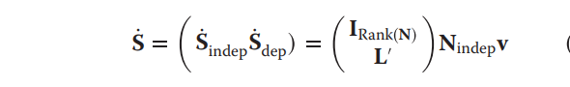
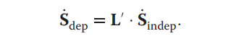
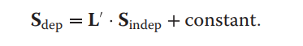
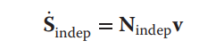
Differential equation system may be rewritten accordingly:
and the dependent concentrations fulfill
Integration leads to
This relation is fulfilled during the entire time course. Thus, we may replace the original system by a reduced differential equation system

Slide 24

Solving ODEs via Matrices
Flashback!

Slide 25
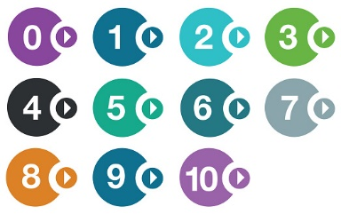
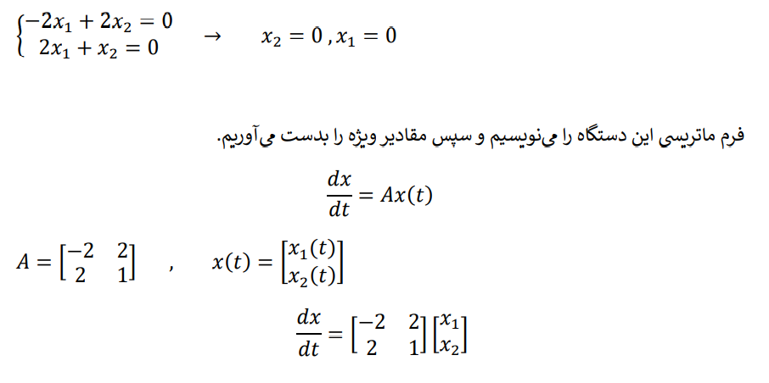
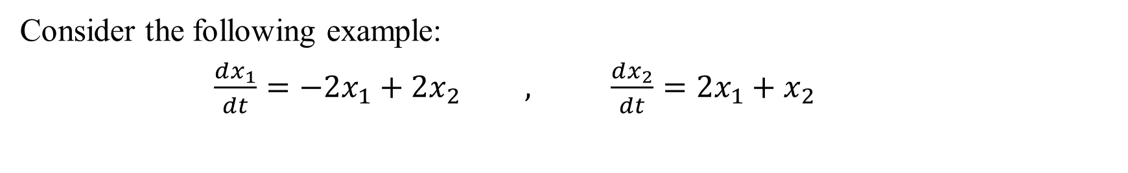
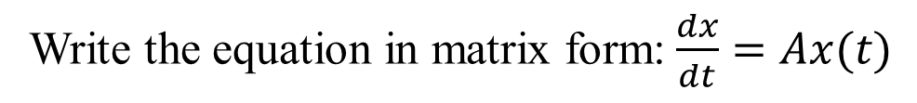
Consider the following example:
$\frac{dx_{1}}{dt}=−{2x}_{1}+2x_{2} , \frac{dx_{2}}{dt}=2x_{1}+x_{2}$
Find the critical points.
Write the equation in matrix form:$\frac{dx}{dt}=Ax(t)$

Slide 26
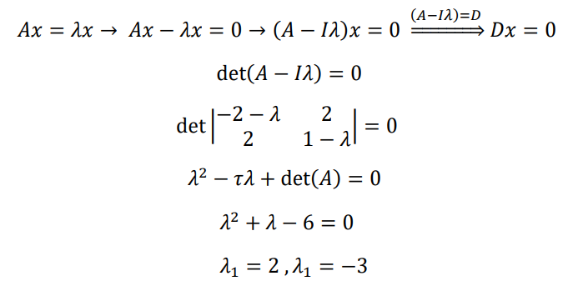
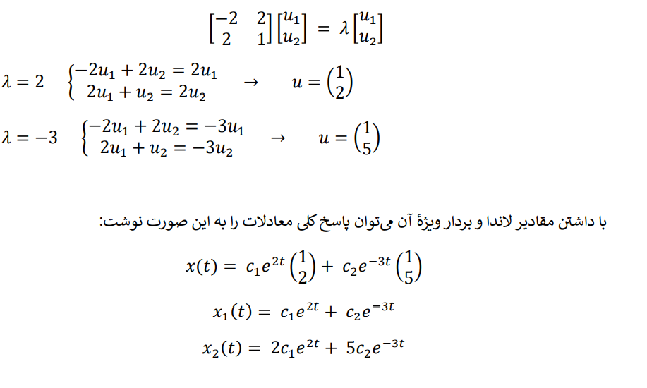
Find eigenvalues.
Find eigenvectors.

Slide 27
Find the ODE system solution.

Slide 28
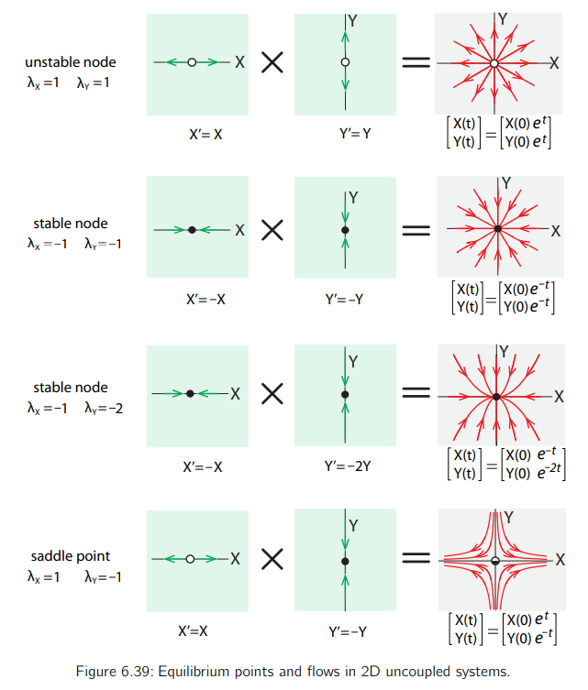

Slide 29
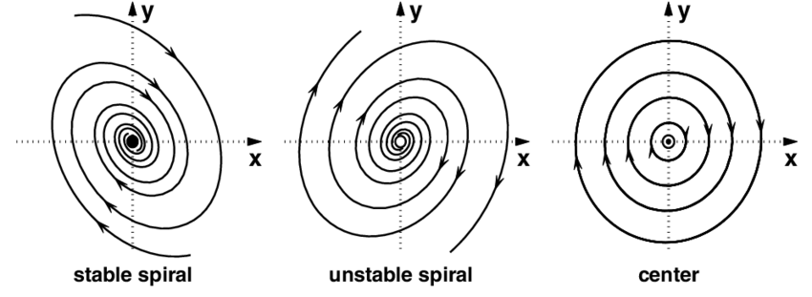
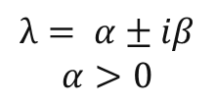

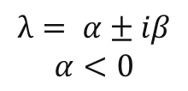
$$λ= α±iβ$$
$$α<0$$
$$λ= α±iβ$$
$$α>0$$
$$λ= α±iβ$$
$$α=0$$

Slide 30
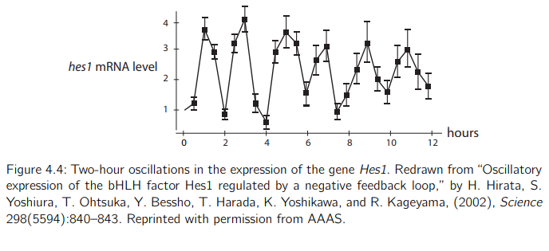
Hopf Bifurcations: Oscillatory Gene Expression
Genes are often under regulation that causes them to express in an oscillatory pattern, with cycles ranging from hours to days. Oscillatory gene expression has been detected in many genes, including Hes1, which is critical in neural development, and p53, the “guardian angel gene,” which is critical in cancer regulation.

Slide 31
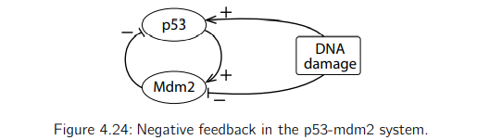
Rhythmic gene expression has to be coordinated to, and in some cases actually drive, these rhythmic processes. Therefore, cells have evolved mechanisms to produce oscillatory gene expression. Most of these mechanisms depend on some kind of negative feedback, where the gene produces a product that inhibits that very gene.
The occurrence of oscillations is generally caused by the presence of a negative feedback loop in the regulatory network.

Slide 32
Hopf bifurcation theorem (approximately)
Consider an equilibrium point of a vector field that depends on a parameter. Let J be the Jacobian matrix representing the linear approximation to the vector field at that equilibrium point. Suppose that a pair of conjugate eigenvalues of J, a ± bi passes from a < 0 to a > 0 as a parameter passes a critical value. In this case, the behavior changes from a stable equilibrium to an unstable equilibrium surrounded by a stable limit cycle attractor.

Slide 33
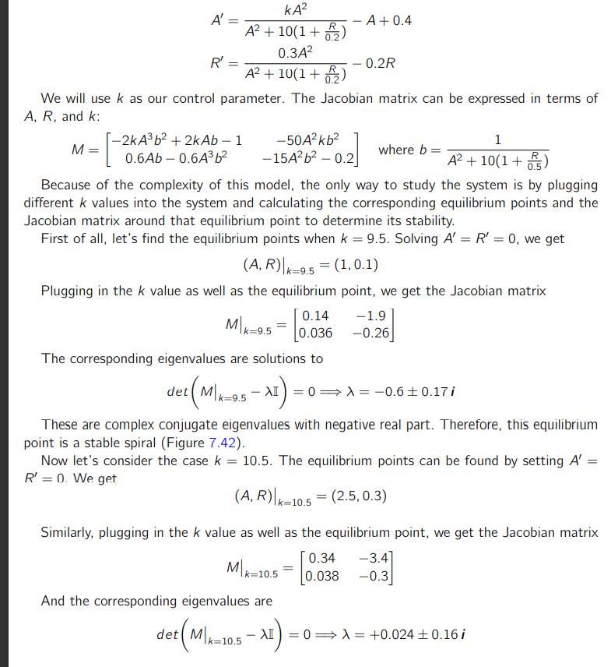

Slide 34
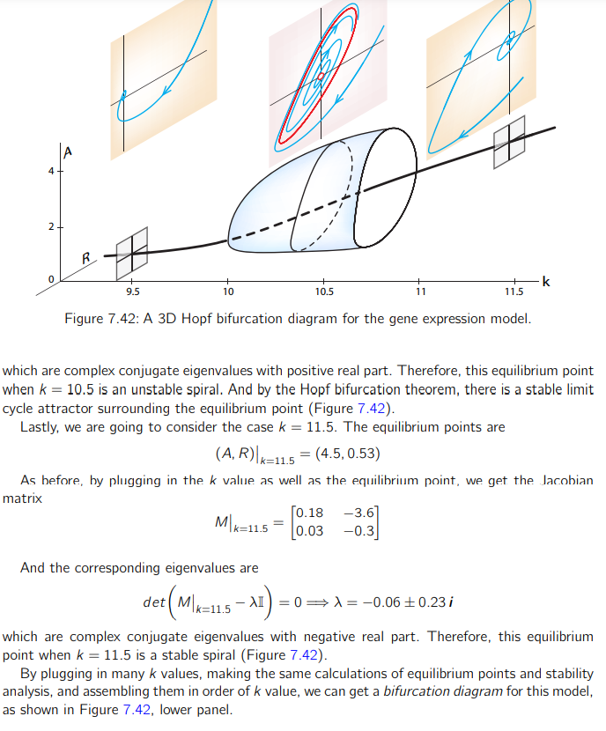

Slide 36
References
[1] Klipp, E., Liebermeister, W., Wierling, C., & Kowald, A. (2016). Systems Biology: A Textbook (2nd ed.). Wiley-Blackwell.
[2] Garfinkel, A., Shevtsov, J., & Guo, Y. (2017). Modeling Life: The Mathematics of Biological Systems (1st ed. 2017 ed.). Springer.
[3] Li, W., Krishna, S., Pigolotti, S., Mitarai, N., & Jensen, M. H. (2012). Switching between oscillations and homeostasis in competing negative and positive feedback motifs. Journal of Theoretical Biology, 307, 205–210. https://doi.org/10.1016/j.jtbi.2012.04.011
[4] Alon, U. (2019). An Introduction to Systems Biology: Design Principles of Biological Circuits (Chapman & Hall/CRC Computational Biology Series) (2nd ed.). Chapman and Hall/CRC.
[5] Neuhauser, C. (2022). Calculus For Biology and Medicine (Calculus for Life Sciences Series) 3th (third) edition. Pearson.
[6] Vignoni, A. (2020, June). Modeling: ODEs and Hill Functions Section 1: ODEs, Law of mass action and the central dogma [Poster session]. Synthetic Biology and BiosystemsControl Lab, Valencia, Valencia.

